Slide 1


EMPLOYEE MANAGEMENT SYSTEM
IGATE is now a part of Capgemini
Notes:
Copyright © 2011 IGATE Corporation (a part of Capegemini Group). All rights reserved.
No part of this publication shall be reproduced in any way, including but not limited to photocopy, photographic, magnetic, or other record, without the prior written permission of IGATE Corporation (a part of Capegemini Group).
IGATE Corporation (a part of Capegemini Group) considers information included in this document to be confidential and proprietary.

Slide 2

Team Members
SAURABH J.DUBEY
VINIT A.SURYARAO
SHUBHAM K.AGRAWAL
KARNADEEP M.RANA
KARAN P.CHAVAN
SHRUTI K.JAMGADE

Slide 3
Project Details
Employee Management System is designed to assist the strategic planning and to maintain employee details.
It is simple and user friendly application to perform organizational operations.
Application follows modularization approach to perform operations like …

Slide 4
Project Details
Operations :-
Login
Add/Remove Employees
View Employee Details
Update Employee Details
Search Employee Details
Assign Projects
View Upcoming Birthdays
Change Themes

Slide 5
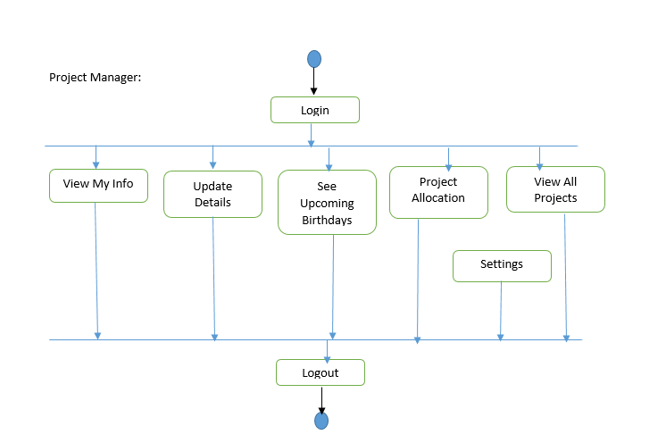
Activity Diagrams

Slide 6
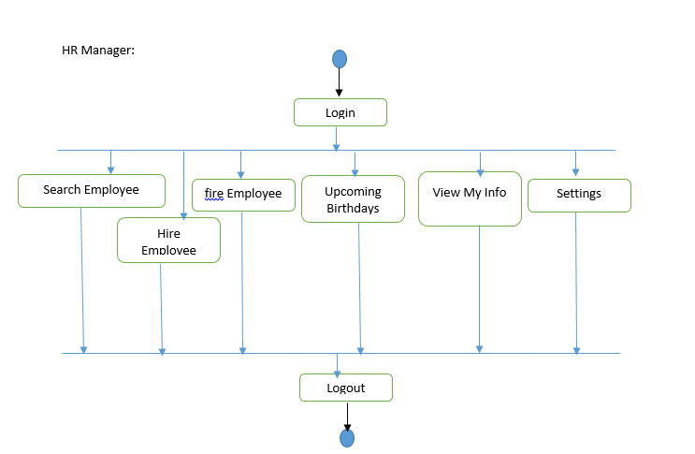
Activity Diagram

Slide 7
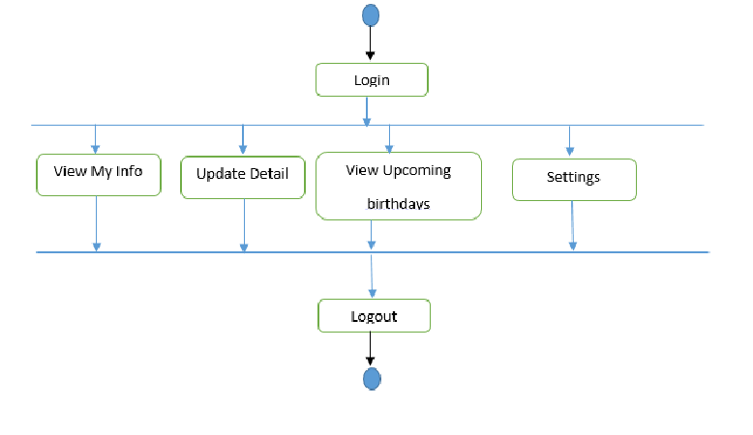
Activity Diagram

Slide 8
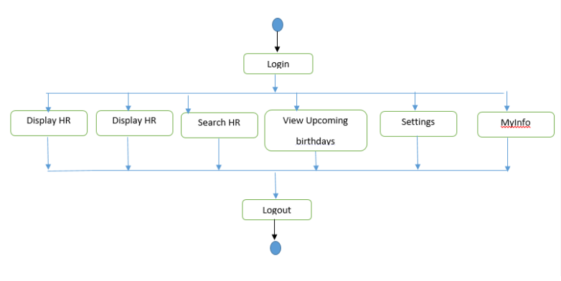
Activity Diagram

Slide 9
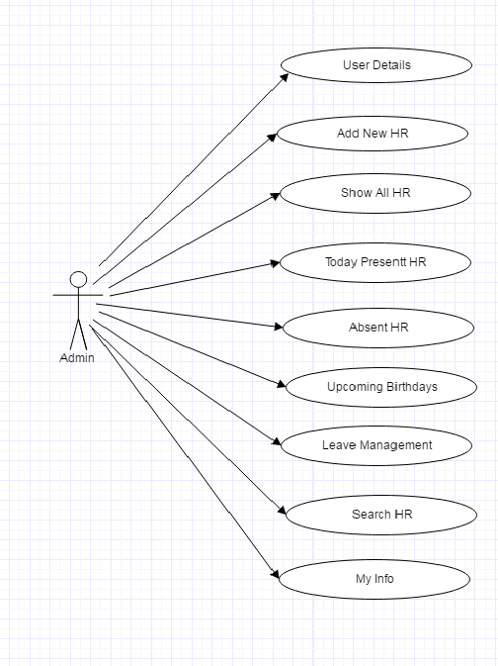
Use Case Diagram
Admin Operations

Slide 10
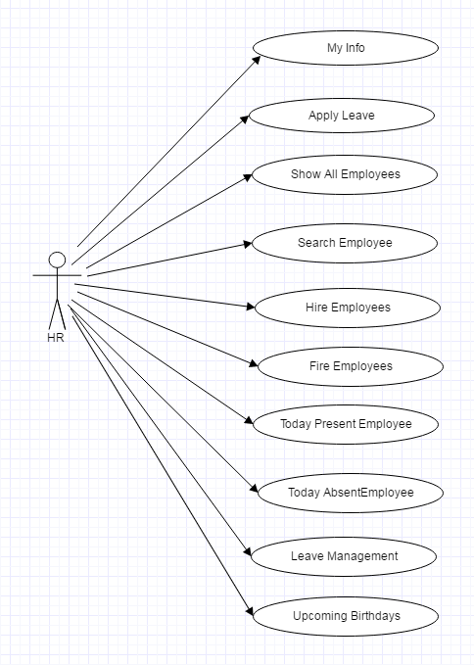
Use Case Diagram
HR Operations

Slide 11
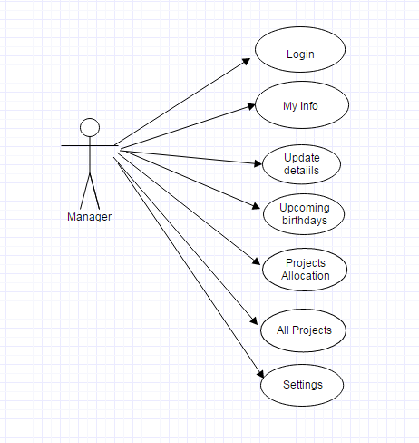
Use Case Diagram
Manager Operations

Slide 12
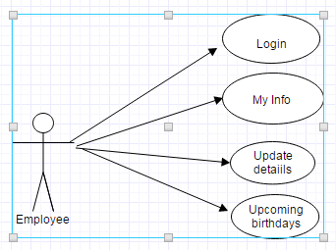
Use Case Diagram
Employee Operations

Slide 13
Future Enhancements
This application can be supported using distributed architecture.
Application can support the finance module operations.
Real time notifications, organizational news features can be added to application.
Email system can also be included in the application

Slide 14
Thank You

